Slide 1
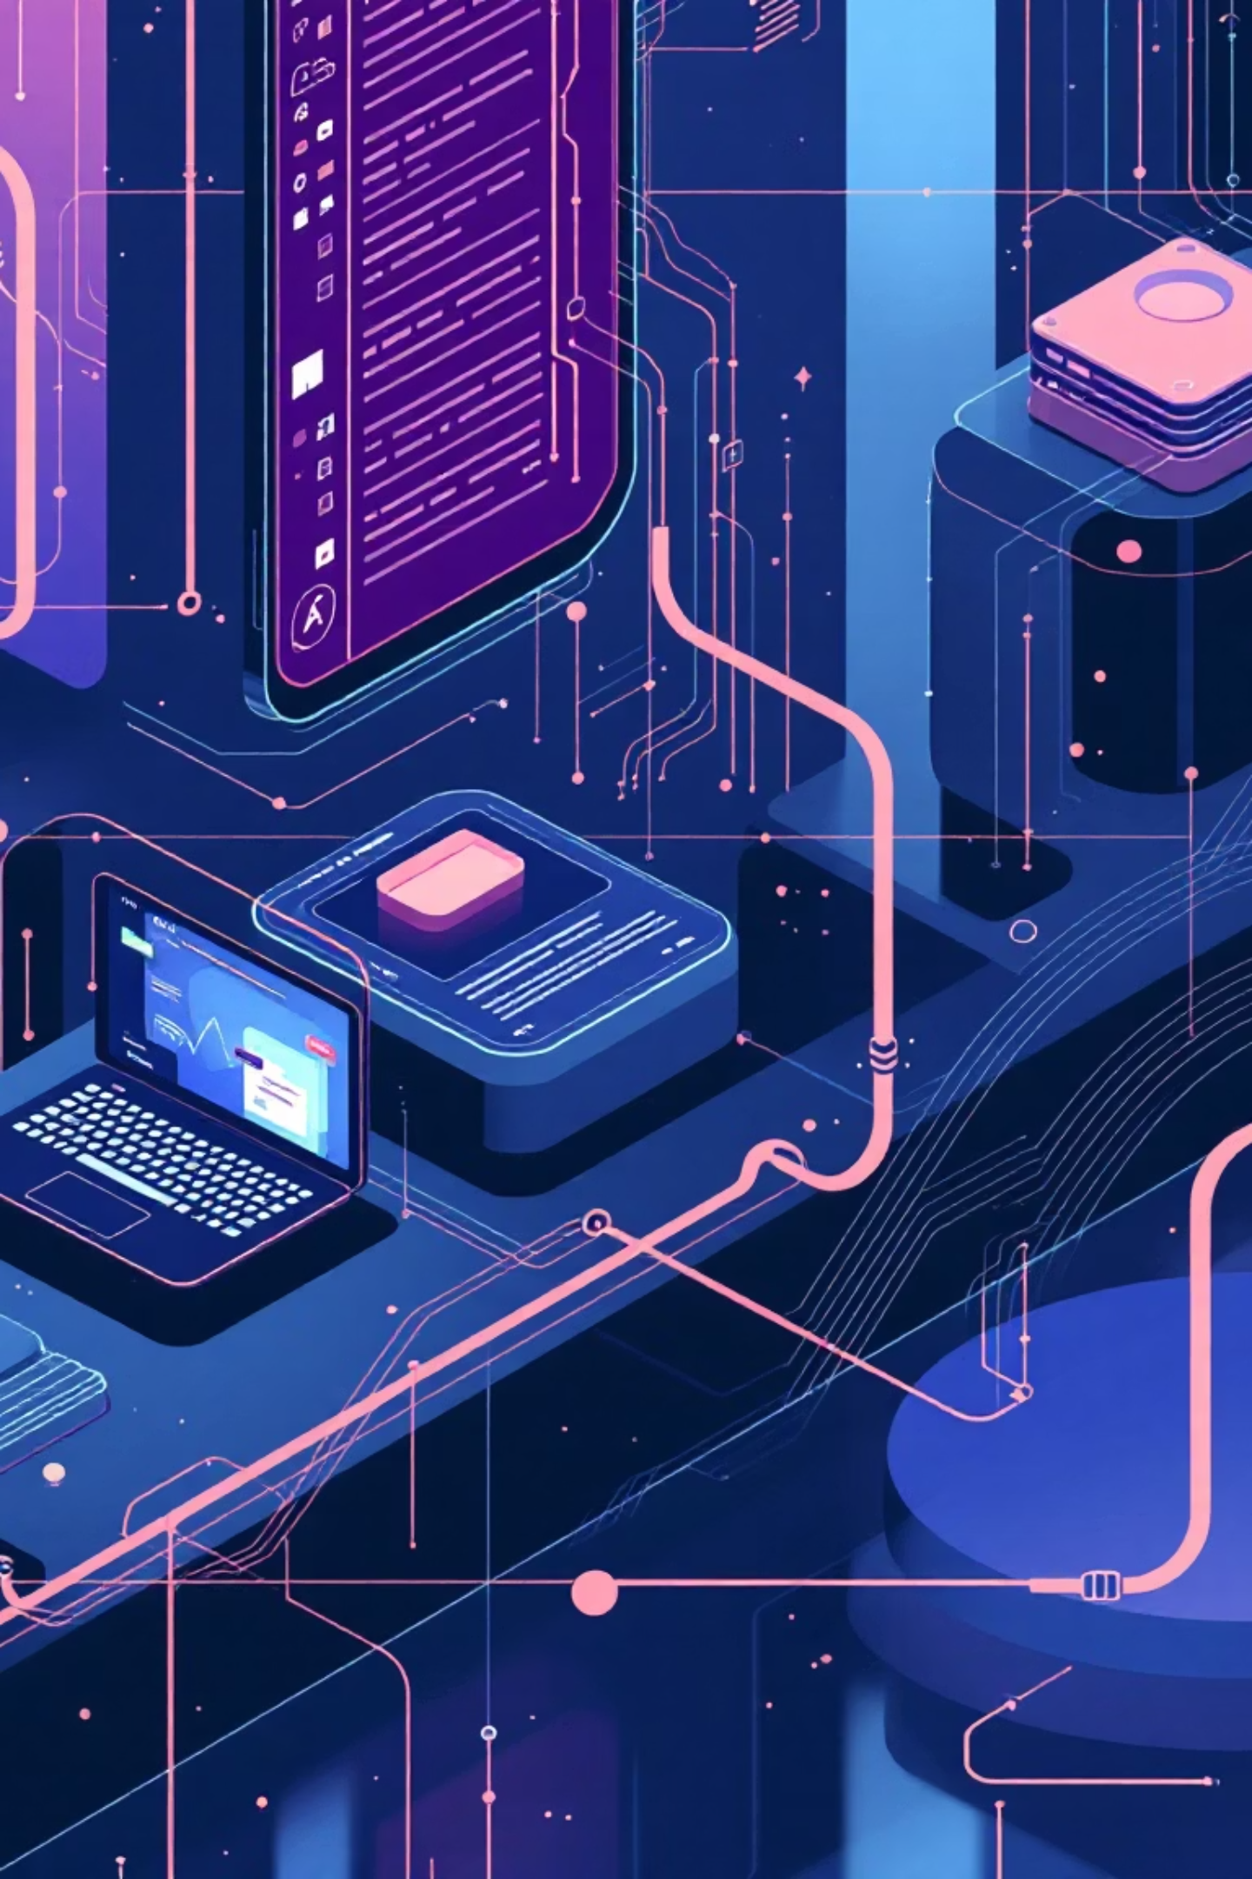
Infosys Springboard Internship -
NewsPulse Global News Trend Analyzer Using AI
Transforming how product managers and engineers interact with real-time news through intelligent, conversational analysis

Slide 2

What is Newspulse?
Newspulse is an interactive Streamlit-based application that delivers real-time news analysis and intelligent insights. By integrating Google Gemini AI, it creates a conversational experience that goes beyond traditional news consumption.
The platform combines live news fetching with advanced natural language processing to help teams understand not just what's happening, but why it matters.

Slide 3




Core Capabilities
Live News Fetching
NLP Analysis
Access top headlines instantly or search by keyword using the GNews API integration for comprehensive coverage
Advanced sentiment detection, keyword extraction, and named entity recognition powered by spaCy and NLTK
Visual Insights
Gemini Chatbot
Interactive charts revealing sentiment trends, frequent entities, and emerging topic patterns at a glance
Conversational AI that summarises articles, explains context, compares stories, and answers queries intelligently

Slide 4
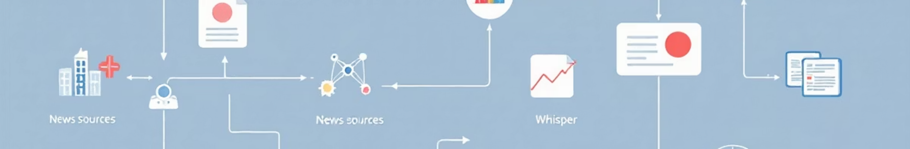




How Newspulse Works?
Fetch
Analyse
GNews API retrieves latest headlines and articles based on topics or keywords
NLP models process content for sentiment, entities, and key themes
Visualise
Interact
Interactive dashboards display trends and patterns through charts
Gemini AI provides conversational insights and answers questions

Slide 5
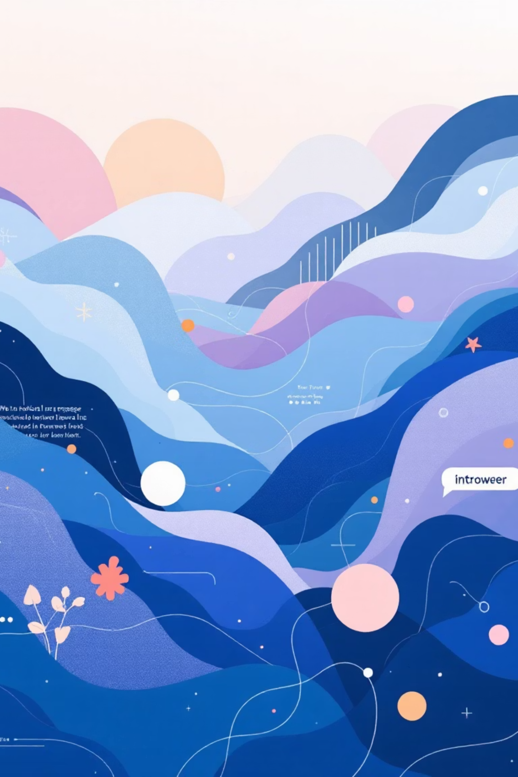
Natural Language Processing in Action
Sentiment Detection
Entity Recognition
Understand the emotional tone of news coverage with advanced sentiment analysis. The platform categorises articles as positive, negative, or neutral, helping teams gauge public perception and media framing.
Automatically identify and extract key people, organisations, locations, and events mentioned in articles. NER capabilities help teams track important actors and understand story networks.
Real-time sentiment scoring
Named entity extraction
Trend analysis across topics
Entity frequency analysis
Comparative sentiment insights
Relationship mapping

Slide 6
Gemini AI: Your Intelligent News Assistant
Summarise Complex Stories
Explain Background Context
Get concise, accurate summaries of lengthy articles in seconds. Gemini distils key points whilst maintaining context and nuance.
Ask for historical background, technical explanations, or industry context. The AI provides comprehensive answers to deepen understanding.
Compare Multiple Sources
Answer Custom Queries
Analyse how different outlets cover the same story. Identify bias, compare angles, and understand diverse perspectives.
Engage in natural conversation about news topics. Ask follow-up questions and explore related themes interactively.

Slide 7

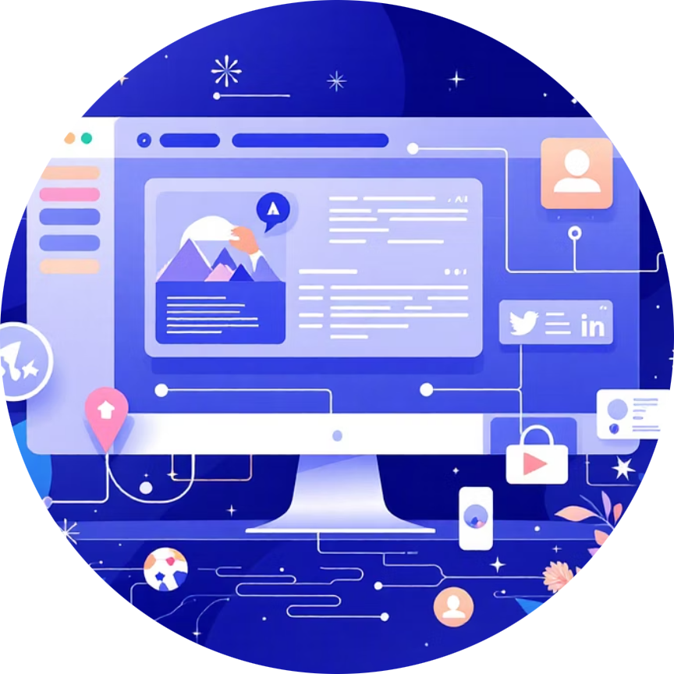

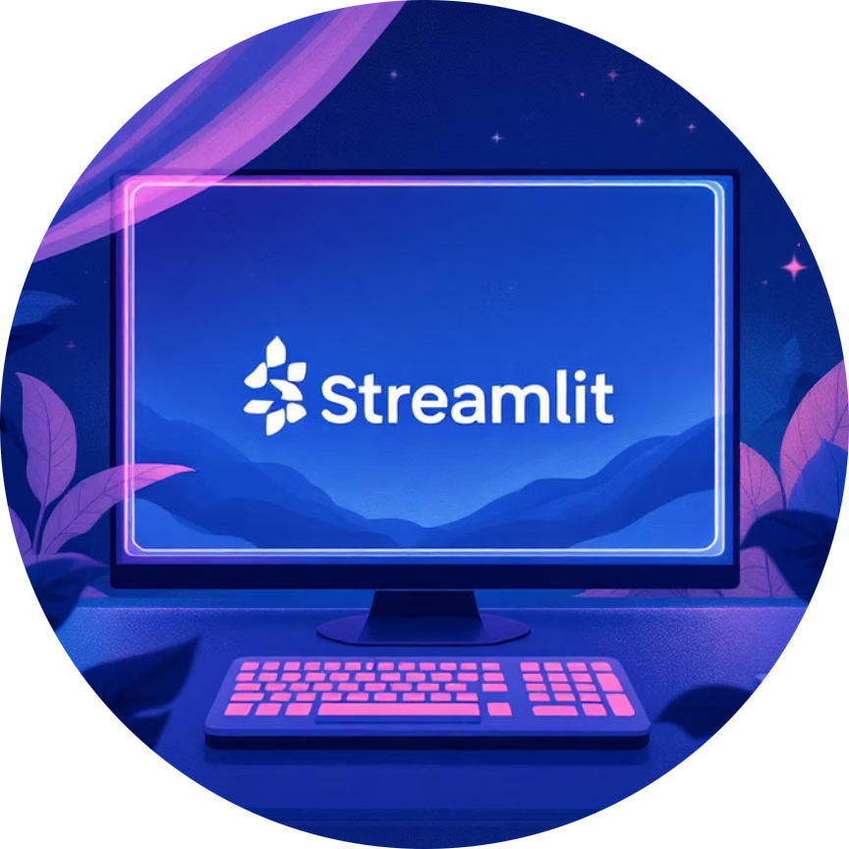


Technical Architecture
Streamlit
Gemini API
GNews API
spaCy & NLTK
Rapid UI development framework enabling interactive web applications
Google's advanced AI for conversational intelligence
Real-time news aggregation from global sources
Industrial-strength natural language processing tools
Plotly
MongoDB
Flexible document database for storing news data and analytics
Interactive visualisation library for rich data displays

Slide 8
Roadmap: Future Enhancements
Multi-Turn Chat Memory
Multilingual Support
Enable contextual conversations that remember previous queries and build on earlier discussions for deeper analysis
Expand language capabilities to analyse and translate news from global sources in real time
1
2
3
4
Multi-Source Summarisation
Voice Interface
Aggregate and synthesise information from multiple articles simultaneously, providing comprehensive topic overviews
Add voice input and audio responses for hands-free news exploration and accessibility

Slide 9

Why Choose Newspulse?
Newspulse offers a powerful solution for staying ahead in a fast-paced news environment. Our platform is designed to provide comprehensive, actionable insights that drive smarter decisions and foster efficient teamwork.
Time Savings: Automate news aggregation and analysis, freeing up valuable time for strategic tasks.
Data-Driven Insights: Leverage advanced analytics to uncover trends, sentiment, and key developments that might otherwise be missed.
Competitive Intelligence: Monitor competitor coverage and industry news in real-time, gaining an edge in market understanding.
Seamless Team Collaboration: Share curated reports, insights, and discussions effortlessly within your organization.
Easy Implementation: Get started quickly with our intuitive interface and robust support, ensuring a smooth integration into your workflow.

